Slide 1
West Elgin Community Health Centre
Presented by Andy Sewpersaud – Senior Underwriter
Paul Sullivan– Brokerage Manager,
November 22nd , 2016

Slide 2
Who is Insured?
The Named Insured:
West Elgin Community Health Centre
Employees
Board and Committee Members
Directors, Officers, Trustees
Volunteers
“While doing work for and on behalf of the organization”
Notes:
The special provisions section of the policy – found on pages 58-63 define the full extent of the team Insured in the HIROC policy
Also covers individuals such as students, medical personnel, trustees etc.

Slide 3
HIROC Coverage Summary
A Bodily Injury (incl. Personal Injury)
A1 Advertising Liability
B Property Damage Liability
B1 Tenant’s Legal Liability
C Professional Liability
C1 Blood Transfusion Legal Liability
D Contingent Employer’s Liability
E Employee Benefits Liability
F Errors and Omissions Liability
G Environment Impairment Liability
H Non-owned Automobile Liability
I Crime Insurance
J Property Insurance
Notes:
You can refer to the attached document 107410 Coverage Summary or one of your underwriters for more information on each coverage

Slide 4
Limits of Insurance
$10 Million any one occurrence
Employee Dishonesty (Coverage I): $2 Million
Crime sub-limits: $200,000
No annual aggregates
No deductibles
Generous retroactive clause
Unlimited legal and defence costs (in addition to your $10m liability limit)
Notes:
Note that employee dishonesty covers losses against the Insured and not third parties. For example, it does not cover an Social Worker stealing from a patient. It is in relation to various type of theft to the employer (Money from a safe, property damage due to the act, money while in transit with a messenger etc.)

Slide 5
Errors and Omissions Liability
HIROC’s version of D&O
Covers Trustees, Officer’s, Director’s, Members of Boards or Committees, Officers/Board Members of volunteer and auxiliary associations, and employees.
Insurance covers not only judgments or settlements arising from allegations but also the costs to defend against such allegations whether groundless or not.
Notes:
In the general insurance market there are separate coverage options for Errors and Omissions and Directors and Officers. This is because not all organizations in the general marketplace have these exposures. All of our HIROC subscribers however do have this exposure so we have combined the coverages into one wording.

Slide 6
Directors and Officers Responsibilities
Directors and Officers have a fiduciary responsibility to act in the best interests of the organization
Responsibilities include:
Duty of Loyalty
Duty to Act Honestly and in Good Faith
Duty to Act Prudently
Duty to Act in Timely Manner
Notes:
Will not be considered negligent if these conditions are met – they have to breach their fiduciary responsibilities in order for them to be liable

Slide 7
Possible grounds for claims against Directors and Officers
Discrimination
Actions beyond granted authority
Breach of Fiduciary Duties
Improper Advice
Wrongful Dismissal

Slide 8
Cyber Liability / E-Commerce
Coverage has been extended to include fees, costs and expenses, including claims expenses, fines and/or penalties for the following:
Privacy Notification Costs
Forensic Investigations
Credit Monitoring
Fines & Penalties
Regulatory Hearings and Proceedings
The above are newly added enhancements to the Cyber Liability /
E-Commerce coverage, up to a total limit of $200,000 collectively.

Slide 9
Occupational Accident Coverage (O.A.C.)
Occupational Accident for full and part time employees
- Accidental Death and Dismemberment
- Weekly Accident Indemnity for injuries
Available for Volunteers also
- $10 per person
- $50,000 for AD & D
- $50 per week for injured volunteer (payable for 26 weeks after 4 day waiting period)
- Higher limits available

Slide 10
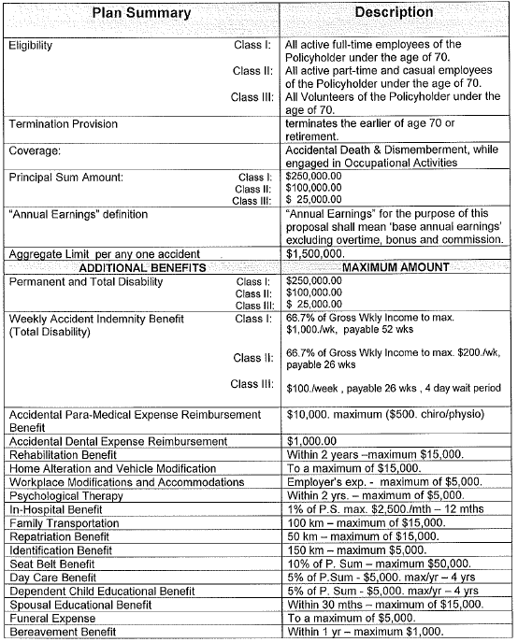
O.A.C. Insurance Sample Plan

Slide 11
Property Coverage
We are able to quote a Property policy which would include coverage for contents and equipment (All Risk)
Property coverage also includes first party cyber coverage for damage to your data, network or software as well as the resultant Business Interruption Coverage.

Slide 12
Questions?

