Slide 1
Community Health Services
Presentation for WECHC
Board Orientation
October 2023

Slide 2
Community Services Teams CHC funded*
Health Promotion Team
1 Health Promoter
1 Systems Navigator
1 Homelessness Systems Navigator (on contract)
1 Youth Advocate NEW! (Full time contract position)
Let’s Connect (Early Years) Team
1 RN, 1 Dietitian, 1 ECE,
Mental Health Team
3 Therapists
* CHC Services use PS Suites for their EMR-Electronic Medical Record

Slide 3
Community Services Teams CSS Funded*
Community Support Services for Seniors and Adults with Disabilities Team (CSS)
1 Volunteer /CSS Coordinator NEW!
(30 hours-4 days a week position)
1 CSS Life Enrichment Lead (Full time)
CSS/AL Admin Assistant NEW! (Full time)
WECHC Accessible Van Drivers (Casual)
1 Assisted Living Coordinator (Full time)
1 Assisted Living Client Liaison NEW! (3 days a week)
Full time, part time and casual PSWs/DSWs
*CSS use AlayaCare for their EMR-Electronic Medical Record

Slide 4
Health Promotion Team
Health Promotion is based on the social determinants of health and is more than the absence of disease. It is a resource for living that includes a sense of physical, mental, emotional, spiritual and social wellbeing.

Slide 5
Examples of Social Determinants of Health
Income and social status
Healthy child development
Education
Social and physical environments
Employment and working conditions
Personal health practices and coping skills

Slide 6
Some Current Health Promotion Team Programs
Men’s Cooking class
Smoking Cessation Counselling/Quit Cafe
Community Health and Wellbeing Week activities
Community Gardens (West Lorne and Rodney)
Social Prescribing

Slide 7
Systems Navigation
Assist individuals in navigating the health system, community programs and supports, and social services.
Rural Homelessness Systems Navigator assists those at immanent risk of homelessness or experiencing homelessness. Funding from the City of St. Thomas provides this position which covers West, East and Central Elgin bypassing St. Thomas who has their own worker for this.

Slide 8
Youth Advocate
Trial run one-year full time contract-currently recruiting
As a member of the Health Promotion team, the Youth Advocate
helps to reimagine how the Centre’s care and services can improve
equitable health and well-being outcomes for youth (ages 10-18) with
a focus on supporting the mental health of youth and young families.
This position will connect with the communities’ youth to identify,
understand, and address issues that are important to young people
as well as provide programming, group facilitation, social prescribing
and systems navigation. Our Youth Advocate works towards
improvement of multiple areas of youth and and young family support
through advocacy and community action.

Slide 9
Community Services Teams
Dietitian Services
Registered Dietitian: Nutrition Support and Advice for individuals and families
(all ages) (non-diabetic)

Slide 10
Community Services Teams
Let’s Connect (Early Years) Programs
Registered Nurse: Breastfeeding Support and Advice
Registered Early Childhood Educator: Individual tutoring
Prenatal Classes
Grow with Baby (Dutton, Rodney, Glencoe)
Kitchen Kids
Baby Food Making/Beyond Baby Food Making

Slide 11
Community Services Teams
Let’s Connect (Early Years) Sample Programs
Cooking Kids
Krazy Kitchen
Collective Kitchen Opportunities
Craving Change
Count Down to Christmas
At the Kitchen Table (10-12 years old)
Danceplay
Zumbini

Slide 12
Mental Health Team

Slide 13
Community Services Teams
Mental Health Team
Child and Youth Therapist:
Melanie Silos-Crowell, M.S.W.
Adult Therapists
Robert Wojkowski, M.Sc. OT Reg. (Ont.)
Jon Turalinski, Psychotherapist
Reg. Ontario of Psychotherapy

Slide 14
Description of Services
Services include:
RAM appointments
Individual counselling and therapy
Couples counselling
Eligibility
Medical Provider not needed
Voluntary Service (Over 12yrs old.)
Free
Through their Primary Care Provider referral clients can have a one-time consultation from a Child/Adult Psychiatrist who is at the Centre once a month.

Slide 15
Some Groups Available to Clients
Happiness 101
Quit Café
Mindfulness
Grief through the holidays
Grief Share (Coming in the New Year)

Slide 16
Community Support Services
Meals on Wheels
Transportation (including accessible vehicle)
Friendly Visiting
Telephone Reassurance
Congregate Dining
Caregiver Support Training, Information and Education
Exercise and Falls Prevention
Digital Navigation Assistance
MS, ABI and Parkinson’s Support groups.
Volunteer Opportunities
Men’s Coffee Break
Java Music Club
Virtual Tours
Arting Around
and many more….

Slide 17
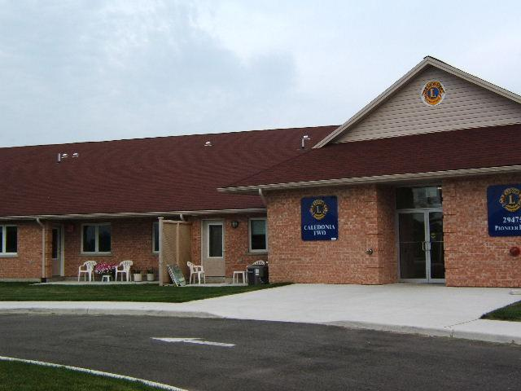
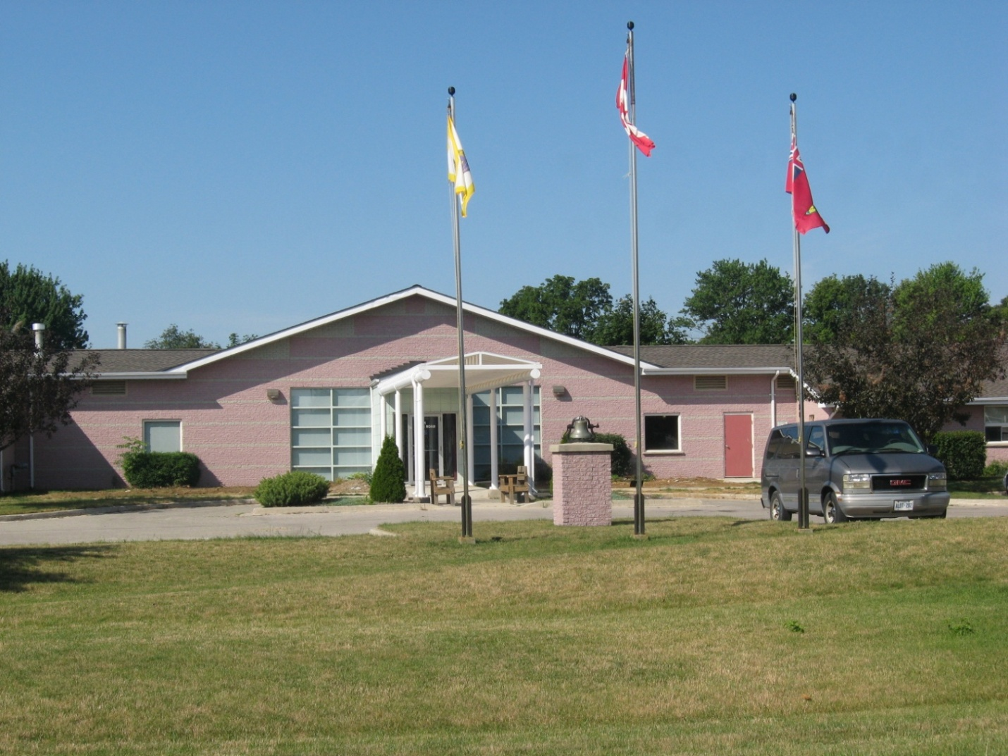
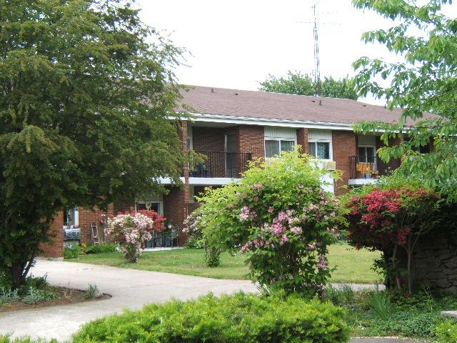
ASSISTED LIVING SERVICES

Slide 18
HISTORY OF PROGRAM
It all started with a small Supportive Housing Program funded through the Ministry of Health in 1998.
The program had 6 clients in 1 building with 4-5 staff members and has since expanded.
CURRENTLY
We currently service 30 clients throughout 4 buildings and in their own homes in the local communities.
As of November 1, 2021, we have office space on Currie Road in Dutton for our Dutton staff to use.

Slide 19
Core Assisted Living Services Available Could Include:
Bathing, dressing, other personal care
Medication assistance and reminders
Grocery help or meal preparation
Hot meal program 7 days/ week through Bobier Villa(Dutton locations only)
Light Housekeeping/laundry
Response in an emergency
Security/Reassurance Checks
Emergency Response

Slide 20
The program provides personal support services and free of charge to seniors and disabled adults with physical disabilities.
Eligibility for AL is determined externally by Home and Community Care Support Services Care Coordinators who make the referrals to our AL program.
Their service requirements must justify the need for the availability of 24-hour service assistance. Currently staff are available by cell from the hours of 10pm-6am and live within a 30-minute response time)
This program allows seniors to age at home, therefore avoiding premature Long Term Care Placement or spending time in a hospital bed awaiting another level of care option.

Slide 21
WECHC is a keen advocate of education for our PSW/DSW staff. Examples of training includes such areas as:
Elder Abuse
Geriatric Refreshers
Gentle Persuasion
Safe Food Handlers Training,
CPR/First Aid
Dementia Education
along with a host of other relevant trainings to ensure our staff are well equipped to provide quality support to our AL clients.

Slide 22
Barry’s Committees
Internal
Senior Leadership Team
Operations Team
Healthy Workplace Committee
JEDI-Justice Equity Diversity Inclusion Committee
External
Community Action Network –was on planning group for Community Forum on the Icelandic Model
CSS Council
Dutton Dunwich West Elgin Housing Stability Coalition
Housing Stability Alliance , St. Thomas-Elgin
Elgin Ontario Health Team (OHT) Digital Sub-committee

Slide 23
QUESTIONS?
Thank you for your time!

