Slide 1
Community Health Services
Presentation for WECHC
Board Orientation
October 2021

Slide 2
Community Services Teams CHC funded
Health Promotion Team
1 Health Promoter/System Navigator,
1 Health Promoter/Community Developer
1 Homelessness Systems Navigator (on contract)
Let’s Connect (Early Years) Team
1 RN, 1 Dietitian, 1 ECE, 1 Child and Youth Worker
Mental Health Team
2 Social Workers, 1 O.T.

Slide 3
Community Services Teams CSS Funded
Community Support Services for Seniors Team
1 Community Support Services for Seniors and Adults with Disabilities/Volunteer Coordinator
1 CSS Life Enrichment Lead
1 Assisted Living Staffing Coordinator
1 Assisted Living Client Services Coordinator
Full time, part time and casual PSWs/DSWs

Slide 4
Community Services Teams
Health Promotion Team
Stephanie Skelding, R.N.
Health Promoter/Systems Navigator,
Diane Van Dyk,
Health Promoter/Community Developer
Tanya Dale
Homelessness Systems Navigator

Slide 5
Definition of Health Promotion
Health Promotion is based on the social determinants of health and is more than the absence of disease. It is a resource for living that includes a sense of physical, mental, emotional, spiritual and social wellbeing.
Notes:
STEPHANIE - Read the slide.

Slide 6
Examples of Social Determinants of Health
Income and social status
Healthy child development
Education
Social and physical environments
Employment and working conditions
Personal health practices and coping skills
Notes:
STEPHANIE - These are some examples of the SDOH. Read the slide. If anyone of these does not exist it decreases a person’s chance to live a healthy life.

Slide 7
Some Current Health Promotion Activities
Men’s Cooking class
Healthy Beginnings, Healthy Life
Smoking Cessation Counselling/Quit Cafe
Community Health and Wellbeing Week activities
Community Gardens (West Lorne and Rodney)
Social Prescribing
Notes:
Diane - Trained as facilitators for this peer led workshop – one workshop annually – completed one in May of 2012 with 12 participants and a second one in March/April of this year with 4 participants – another taking place starting April 3 in 2014
Stephanie – BP clinics are supervised by me as a Registered Nurse, but most clinics are run by a Centre volunteer. BP clinics occurs the 1st and 3rd Monday of each month at our Soup’s On congregate dining program and every 2nd Monday of the month here at the centre from 1-2 pm and anyone is welcome to attend.
Diane - Men’s cooking class runs every fourth Tuesday of the month – usually around 10 participants - men learn to cook and are taught basic food safety skills, they eat together and learn about various health promotion topics
Stephanie - Healthy living Tips is a program geared towards any adult with a life altering condition and/or caregivers. It is a monthly program that incorporates health education, physical fitness and alternative therapies such as meditation, massage, RIEKI, stress management with a goal of increasing health and well being for participants
Diane - Smoking Cessation Counselling – The program is called STOP (Smoking Treatment for Ontario Patients) – it is funded by the Ontario Ministry of Health Promotion and Sport and the Ontario Ministry of Long Term Care in partnership with researchers from the Centre for Addiction and Mental Health. In order for someone to participate in this program they must see a clinical provider at the Centre. They are provided with NRT and receive behavioural counselling for their smoking addiction.
Stephanie – Community Health Week occurs the first week of October and is designed to bring to light that health and well being are more than an absence of disease but is a holistic approach to health and well being that encompasses all the SDH.
Stephanie – Flu Clinics open to everyone
Stephanie – Speak up is a national program designed to shed light on the importance of end of life care wishes and how to make you personal end of life care wishes know to your loved one by Speaking UP.
Diane – Youth Safety Day is a partnership with the high school– Takes place every three years at the West Elgin Arena and is full day of presentations by 16 different safety professionals. Topics covered include ATV safety, Farm Safety, Fire Safety, Stranger Safety, water safety etc. Approximately 300 youth in grades 4,5 and 6 participate from all of the local schools. next one June 2015
Kim – Healthy Beginnings, Healthy Life

Slide 8
Definition of Systems Navigation
Assist individuals in navigating the health system, community programs and supports, and social services.
Notes:
STEPHANIE - Although both of us share the role of Health Promoter we also have a different role attached to our title.
Stephanie – As a Systems Navigator I am a catalyst for change in people’s lives. I liaison and link people with other services, I educate people on what is available to them to assist with whatever the issues may be at the time, I advocate on behalf of clients in hopes of increasing the person’s overall well-being.
Some examples of this are, informing of programs and services available, making referrals, advocating for income supports, assisting with completion of forms, connecting with service clubs for financial assistance. The system navigation role has no age criteria and assists with just about all forms of health, community and social support issues.

Slide 9
Definition of Community Development
The Community Developer seeks to empower individuals and groups of people by providing them with the skills they need to effect change in their own communities.
Community Development starts from the principle that within any community there is a wealth of knowledge and experience which, if used in creative ways, can be channeled into collective action to achieve the communities' desired goals. Examples:
Food Security-Community Gardens, Good Food Box Program
2019 Canadian Index of Wellbeing Survey
Homelessness and Housing Stability work
Notes:
DIANE - The other part of my role is Community Development.
Read the slide.
For the next while along with the work I do as a health promoter, I will be working on a food security project. The definition of FS is “When all people, at all times have physical and economic access to sufficient, safe and nutritious food to meet their dietary needs and food preferences for an active and healthy life.” This project addresses the WECHC’s second strategic direction of improving community capacity building for advocating for improvements in the health, social and economic conditions our communities face and helping people advocate for themselves. A Food Security Task Group has been established. Members include staff, and representatives from EPH, YWCA, Food Banks. The activities involved in this project include “ideas’ workshops” with schools, factories and the general communities. Through the workshops we will determine the assets available in our community that allow people to access food as well as generate ideas to ensure everyone in WE has access to enough safe and nutritious food to keep them healthy. The goal is to assist community members with the resources they need to turn their ideas into reality.
WESS – May 27
Ald – May 28
WESES - June 4
DD PS – June 6
St. Mary’s – June 10
Erie Flooring – Aug 15
Dutton – September 25
Rodney – September 30
Upcoming CD projects include a community assessment that entails collecting both qualitative and quantitative data on a wide range of community characteristics. In may include doing a demographic profile of the community, as well as community surveys, a community asset mapping exercise, an environmental scan, focus groups and interviews with key community members.

Slide 10
Community Services Teams
Let’s Connect (Early Years) Team
Debi Feasey R.N.
Larissa Church R.D.
Cindy DaCosta, E.C.E
Kelly Patterson , Child and Youth Worker (CYW)
Larissa: Registered Dietitian: Nutrition Support and Advice for individuals and families
(all ages) (non-diabetic)

Slide 11
Community Services Teams
Let’s Connect (Early Years) Programs
Registered Nurse: Breastfeeding Support and Advice
Registered Early Childhood Educator: Individual tutoring up to grade 2
Prenatal Classes
Grow with Baby (West Lorne, Dutton, Rodney)
Kitchen Kids
Baby Food Making/Beyond Baby Food Making

Slide 12
Community Services Teams
Let’s Connect (Early Years) Sample Programs
Cooking Kids
Krazy Kitchen
Collective Kitchen Opportunities
Craving Change
Count Down to Christmas
Around the Kitchen Table (10-12 year olds)
Car Seat Education
Large Community Events: Teddy Bear Picnic, Fall Family Fun Night

Slide 13
Mental Health Team

Slide 14
Community Services Teams
Mental Health Team
Melanie Silos-Crowell, M.S.W.
Robert Wojkowski, M.Sc. OT Reg. (Ont.)
Amanda Blackburn, M.S.W.

Slide 15
Description of Services
Services include:
RAM appointments
Individual counselling and therapy
Couples counselling
Eligibility
Medical Provider not needed
Voluntary Service (Over 12yrs old.)
Free
Notes:
Mel

Slide 16
Services Available to Clients
Age breakdown:
Up to 18yrs old (Mel)
18-64 yrs old (Rob and Amanda)
WECHC clients can access specialized assessment: Child and Adult Psychiatry
Notes:
Rob

Slide 17
Some Groups Available to Clients
Happiness 101
Quit Café
Sleep Better
Mindfulness
Working with Emotions
Notes:
Rob

Slide 18
Community Services Teams
Community Support Services Team (CSS)
Shelly Vergeer, CSS/Volunteer Coordinator
Jenna Noorenberghe, CSS Life Enrichment Lead

Slide 19
Community Support Services available for seniors in the West end of Elgin County Some examples:
Meals on Wheels
Transportation (including accessible vehicle)
Friendly Visiting
Telephone Reassurance
Congregate Dining
Caregiver Support Training, Information and Education
Exercise and Falls Prevention
Digital Navigation Assistance
MS, ABI and Parkinson’s Support groups.
Volunteer Opportunities

Slide 20
Our Teams
Community Services Teams
Assisted Living Team
1 A.L. PSW Coordinator- Betty Jo Drent
1 A.L. Client Services Coordinator-Tobi Maniacco
Full Time, Part time and Casual staff, PSWs and DSWs.

Slide 21
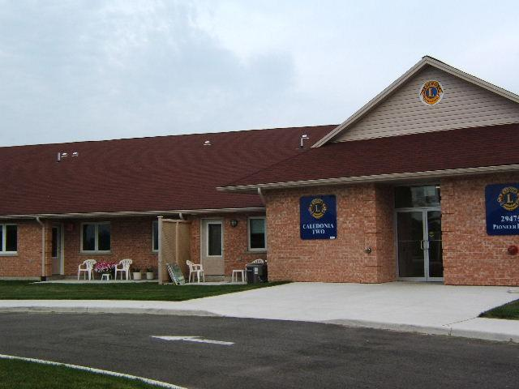
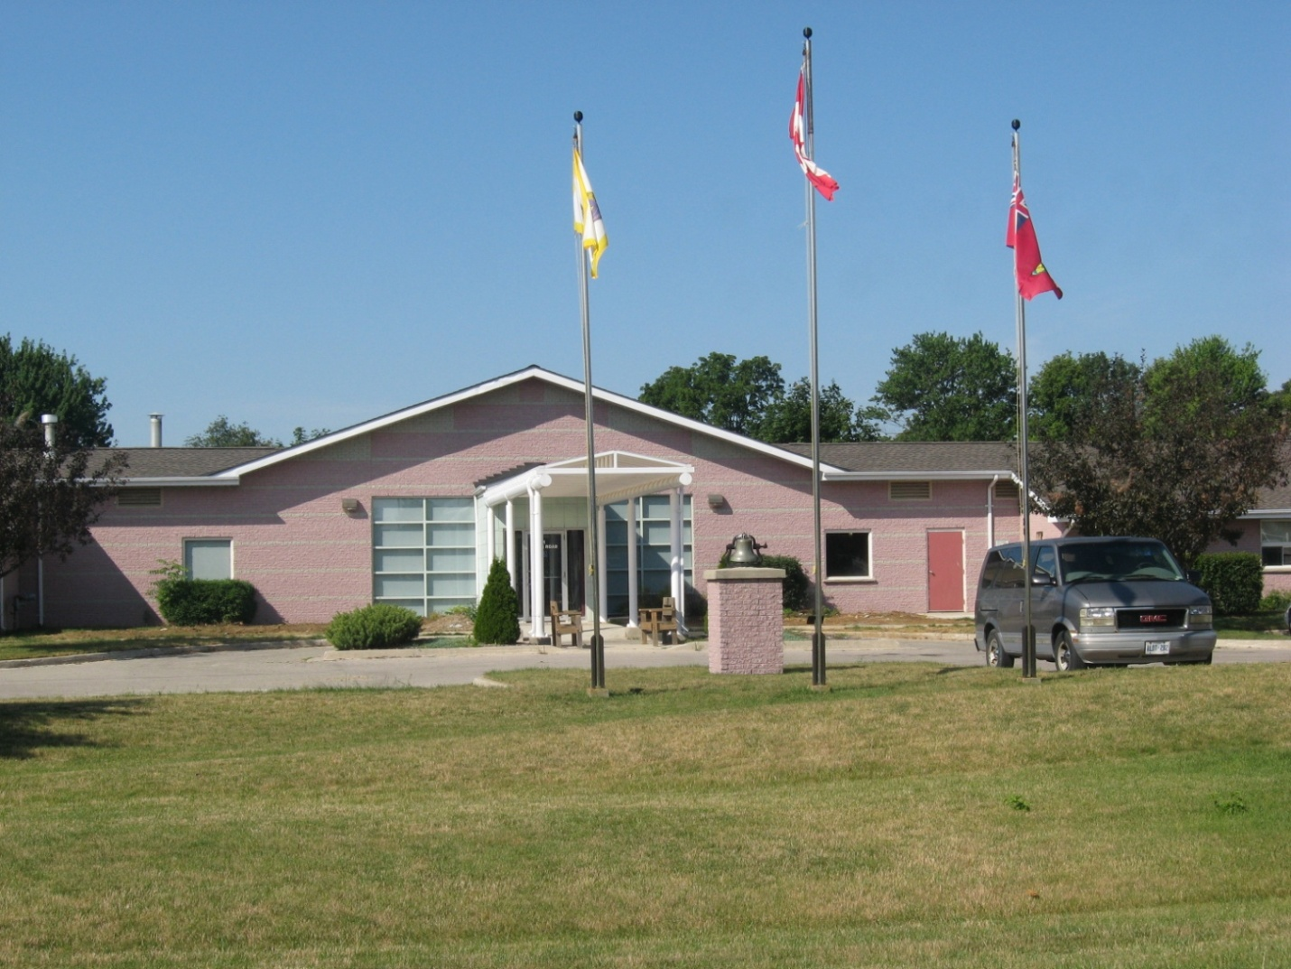
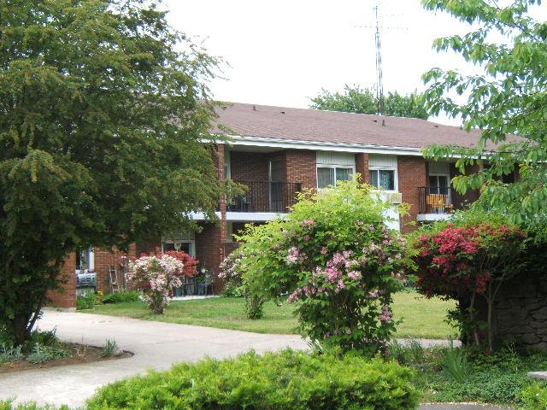
ASSISTED LIVING SERVICES

Slide 22
Core Services Available Could Include:
Bathing, dressing, other personal care
Medication assistance and reminders
Grocery help or meal preparation
Hot meal program 7 days/ week through Bobier Villa(Dutton locations only)
Light Housekeeping/laundry
Response in an emergency
Security/Reassurance Checks
Emergency Response

Slide 23
HISTORY OF PROGRAM
It all started with a small Supportive Housing Program funded through the Ministry of Health in 1998.
The program had 6 clients in 1 building with 4-5 staff members and has since expanded.
CURRENTLY
We currently service 28 plus clients throughout 4 buildings and in their own homes in the local communities.
As of November 1, 2021 we will have office space on Currie Road in Dutton for our Dutton staff to use.

Slide 24
The program provides personal support services and essential homemaking services free of charge to seniors and disabled adults with physical disabilities.
Their service requirements must justify the need for the availability of 24-hour service assistance. Currently staff are available by cell from the hours of 10pm-6am and live within a 30-minute response time)
This program allows seniors to age at home, therefore avoiding premature Long Term Care Placement or spending time in a hospital bed awaiting another level of care option.

Slide 25
WECHC is a keen advocate of education for our PSW staff. Training includes:
Elder Abuse,
PSNO
Geriatric Refresher
Foot Care
Therapeutic Touch
GPA
Managing Conflict with angry Clients
Professionalism and service excellence
Healthy Relationship Building and Successful Bonding
Medications for PSW’s
After the 2nd look
Palliative care isn’t just about cancer
Fundamentals of Palliative Care
Advanced Palliative Care
Food Handlers Certificate
CPR/First Aid

Slide 26
Home Support Exercise Program
Dealing with difficult behaviours
Stress Management
Parkinson’s Education Program (10 modules)
U-First
Elgin Elder Abuse
Alzheimer’s Society-Information series
Working with clients with Diabetes
Intercultural Communication
Blood Pressure Refresher
wound Care for PSW’s
Working with clients with Parkinson’s
Through other eyes Dementia series
Teams that thrive
Overcoming compassion and fatigue
Assistive Devices
Ostomy Care and Management
Client Mobility
ASIST- Applied Suicide Intervention Training
Refresher courses are always provided to keep staff up to date.

Slide 27
QUESTIONS?
Thanks for reviewing

