Slide 1
Community Health Services
Presentation for WECHC
Board Orientation
October 2021

Slide 2
Community Services Teams CHC funded
Health Promotion Team
1 Health Promoter/System Navigator,
1 Health Promoter/Community Developer
1 Homelessness Systems Navigator (on contract)
Let’s Connect (Early Years) Team
1 RN, 1 Dietitian, 1 ECE, 1 Child and Youth Worker
Mental Health Team
2 Social Workers, 1 O.T.

Slide 3
Community Services Teams CSS Funded
Community Support Services for Seniors Team
1 Community Support Services for Seniors and Adults with Disabilities/Volunteer Coordinator
1 CSS Life Enrichment Lead
1 Assisted Living Staffing Coordinator
1 Assisted Living Client Services Coordinator
Full time, part time and casual PSWs/DSWs

Slide 4
Community Services Teams
Health Promotion Team
Stephanie Skelding, R.N.
Health Promoter/Systems Navigator,
Diane Van Dyk,
Health Promoter/Community Developer
Tanya Dale
Homelessness Systems Navigator

Slide 5
Definition of Health Promotion
Health Promotion is based on the social determinants of health and is more than the absence of disease. It is a resource for living that includes a sense of physical, mental, emotional, spiritual and social wellbeing.

Slide 6
Examples of Social Determinants of Health
Income and social status
Healthy child development
Education
Social and physical environments
Employment and working conditions
Personal health practices and coping skills

Slide 7
Some Current Health Promotion Activities
Men’s Cooking class
Healthy Beginnings, Healthy Life
Smoking Cessation Counselling/Quit Cafe
Community Health and Wellbeing Week activities
Community Gardens (West Lorne and Rodney)
Social Prescribing

Slide 8
Definition of Systems Navigation
Assist individuals in navigating the health system, community programs and supports, and social services.

Slide 9
Definition of Community Development
The Community Developer seeks to empower individuals and groups of people by providing them with the skills they need to effect change in their own communities.
Community Development starts from the principle that within any community there is a wealth of knowledge and experience which, if used in creative ways, can be channeled into collective action to achieve the communities' desired goals. Examples:
Food Security-Community Gardens, Good Food Box Program
2019 Canadian Index of Wellbeing Survey
Homelessness and Housing Stability work

Slide 10
Community Services Teams
Let’s Connect (Early Years) Team
Debi Feasey R.N.
Larissa Church R.D.
Cindy DaCosta, E.C.E
Kelly Patterson , Child and Youth Worker (CYW)
Larissa: Registered Dietitian: Nutrition Support and Advice for individuals and families
(all ages) (non-diabetic)

Slide 11
Community Services Teams
Let’s Connect (Early Years) Programs
Registered Nurse: Breastfeeding Support and Advice
Registered Early Childhood Educator: Individual tutoring up to grade 2
Prenatal Classes
Grow with Baby (West Lorne, Dutton, Rodney)
Kitchen Kids
Baby Food Making/Beyond Baby Food Making

Slide 12
Community Services Teams
Let’s Connect (Early Years) Sample Programs
Cooking Kids
Krazy Kitchen
Collective Kitchen Opportunities
Craving Change
Count Down to Christmas
Around the Kitchen Table (10-12 year olds)
Car Seat Education

Slide 13
Mental Health Team

Slide 14
Community Services Teams
Mental Health Team
Melanie Silos-Crowell, M.S.W.
Robert Wojkowski, M.Sc. OT Reg. (Ont.)
Amanda Blackburn, M.S.W.

Slide 15
Description of Services
Services include:
RAM appointments
Individual counselling and therapy
Couples counselling
Eligibility
Medical Provider not needed
Voluntary Service (Over 12yrs old.)
Free

Slide 16
Services Available to Clients
Age breakdown:
Up to 18yrs old (Mel)
18-64 yrs old (Rob and Amanda)
WECHC clients can access specialized assessment: Child and Adult Psychiatry

Slide 17
Some Groups Available to Clients
Happiness 101
Quit Café
Sleep Better
Mindfulness
Working with Emotions

Slide 18
Community Services Teams
Community Support Services Team (CSS)
Shelly Vergeer, CSS/Volunteer Coordinator
Jenna Noorenberghe, CSS Life Enrichment Lead

Slide 19
Community Support Services available for seniors in the West end of Elgin County Some examples:
Meals on Wheels
Transportation (including accessible vehicle)
Friendly Visiting
Telephone Reassurance
Congregate Dining
Caregiver Support Training, Information and Education
Exercise and Falls Prevention
Digital Navigation Assistance
MS, ABI and Parkinson’s Support groups.
Volunteer Opportunities

Slide 20
Our Teams
Community Services Teams
Assisted Living Team
1 A.L. PSW Coordinator- Betty Jo Drent
1 A.L. Client Services Coordinator-Tobi Maniacco
Full Time, Part time and Casual staff, PSWs and DSWs.

Slide 21
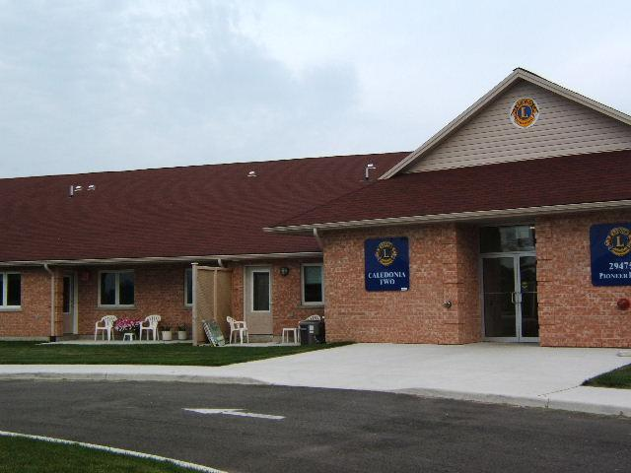
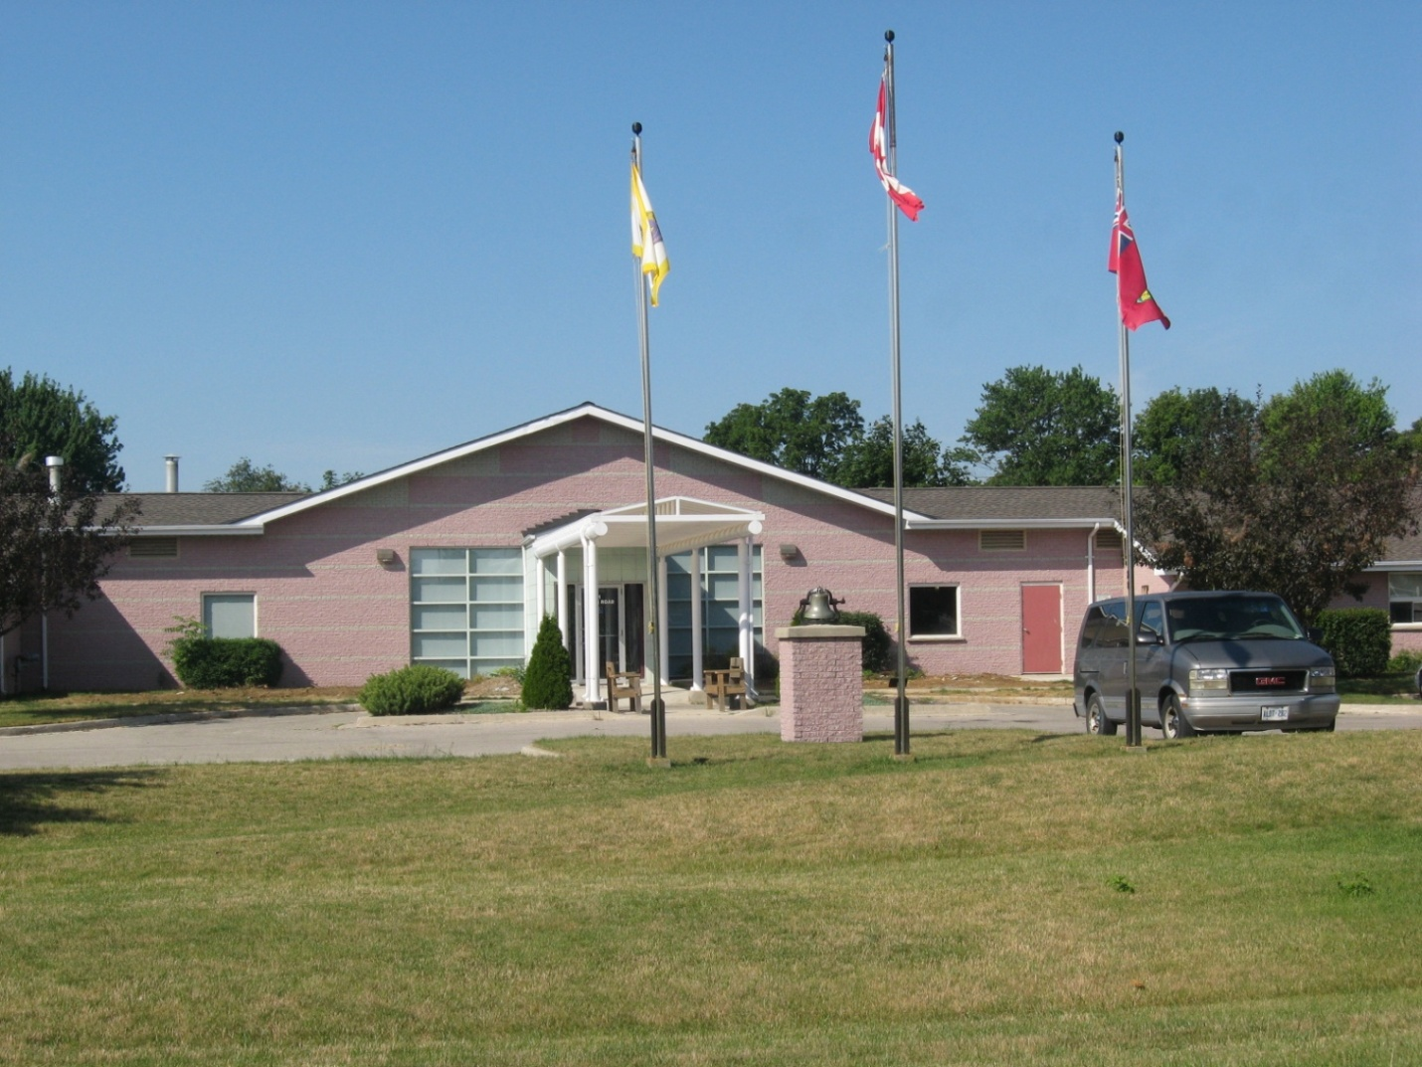
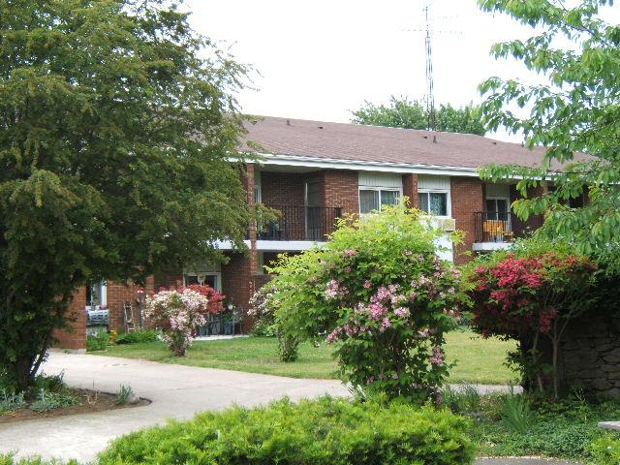
ASSISTED LIVING SERVICES

Slide 22
Core Services Available Could Include:
Bathing, dressing, other personal care
Medication assistance and reminders
Grocery help or meal preparation
Hot meal program 7 days/ week through Bobier Villa(Dutton locations only)
Light Housekeeping/laundry
Response in an emergency
Security/Reassurance Checks
Emergency Response

Slide 23
HISTORY OF PROGRAM
It all started with a small Supportive Housing Program funded through the Ministry of Health in 1998.
The program had 6 clients in 1 building with 4-5 staff members and has since expanded.
CURRENTLY
We currently service 28 plus clients throughout 4 buildings and in their own homes in the local communities.
As of November 1, 2021 we will have office space on Currie Road in Dutton for our Dutton staff to use.

Slide 24
The program provides personal support services and essential homemaking services free of charge to seniors and disabled adults with physical disabilities.
Their service requirements must justify the need for the availability of 24-hour service assistance. Currently staff are available by cell from the hours of 10pm-6am and live within a 30-minute response time)
This program allows seniors to age at home, therefore avoiding premature Long Term Care Placement or spending time in a hospital bed awaiting another level of care option.

Slide 25
WECHC is a keen advocate of education for our PSW/DSW staff. Examples of training includes such areas as:
Elder Abuse
Geriatric Refreshers
Gentle Persuasion
Safe Food Handlers Training,
CPR/First Aid
along with a host of other relevant trainings to ensure our staff are well equipped to provide quality support to our Assisted Living clients.

Slide 26
QUESTIONS?
Thanks for reviewing

