Slide 1
Elgin OHT Governors Briefing Presentation
November 23, 2020

Slide 2
Meeting Overview
Meeting Overview
Review the Ontario Health Teams model
Review the OHT Full Application and development process
Review Full Application sign-off
Questions and Discussion

Slide 3
Overview of Elgin OHT
1
Overview of the Ontario Health Team Model
2
Full Application Development Process

Slide 4
Goals and expectations of Ontario Health Team
An Ontario Health Teams is a group of providers that are clinically and fiscally accountable for delivering a full continuum of care to an attributed population within a specific geographic area.
A key focus of the OHT model is improving the patient experience. Patients will experience improved access to care, improved transitions and coordination of care, and 24/7 coordination and system navigation.
In February 2019, the Ontario Ministry of Health announced a plan to restructure the health system, involving the formation of a new central agency (Ontario Health), and Ontario Health Teams

Slide 5
Potential OHT Benefits for Organizations
Improve care, experience, and outcomes for our patients and their families and caregivers (improved access, navigation and transitions through the system)
Improve the provider experience - enable clinicians and other service providers to foster local collaboration and enable greater communication, collaboration and job satisfaction.
Develop a model of care that protects and strengthens the values and mission of our provider organizations and the unique needs of our community – a “made in Elgin model”
Address the barriers that have limited integration and improvement initiatives in the past.
Be a leader health system transformation and influence the direction of health care in Ontario

Slide 6
Becoming an Ontario Health Team
A group of health care providers self-assembled in Elgin, and decided to initiate system redesign with the aim of becoming an Ontario Health Team
1. Self-Assess Readiness
2. Validate Provider Readiness
3. Become an OHT Candidate
4. Become a Designated OHT
Self-Assessment
Full Application
Begin Implementation
Meet Maturity Criteria

Slide 7
Background
Elgin OHT Steering Committee Members
Community Health Centres | Hospital
West Elgin Community Health Centre Central Community Health Centre | St. Thomas Elgin General Hospital
Community Mental Health & Addictions | Long Term Care
Canadian Mental Health Association - Elgin Middlesex Addiction Services Thames Valley | Caressant Care Nursing & Retirement Homes Ltd. City of St. Thomas County of Elgin and Elgin Manor
 | Palliative Care Service
 | Hospice of Elgin
Community Support Services | Patient Partners
Mennonite Community Services Participation House Alzheimer Society of Elgin/St. Thomas Closing the Gap Healthcare Cheshire – Independent Living Services Victorian Order of Nurses Dale Brain Injury Services | Aaron Berg Jackie Van Ryswyk Pam Close
Family Health Organization | Public Health
Elmdale Family Health Organization Elgin Family Health Organization Windemere Family Health Organization Elmwood Family Health Organization | Southwestern Public Health
Family Health Teams | South West Local Health Integration Network
East Elgin Family Health Team Thames Valley Family Health Team | South West Local Health Integration Network
Partners in Elgin, with the support of a consulting firm, have been collaboratively planning the development of an Ontario Health Team.
Currently, 24 partners from health, community supports services, social and housing sectors and 3 patient partners have been actively engaged in the planning process to submit a full application.

Slide 8
Steering Committee and Sub-Committee Structure
The process for developing the Full Application content is being guided by the Elgin OHT Steering Committee.
Content for the Full Application is being developed by several Sub-Committees focused on key questions to be addressed in the application (i.e., governance, digital health, population health, home and community care, quality and performance).
The process is supported by the Coordinating Council, a smaller group of Steering Committee representatives responsible for planning and coordination of activities.
Steering Committee Meetings
Coordinating Council
Sub-Committee Meetings
Stakeholder Engagement
Governance
Digital Health
Population Health
Home and Community Care
Quality
Performance
8

Slide 9
Revised Full Application Overview
The revised Full OHT Application consists of 6 sections:
1
About your population
4
How will you transform care?
1
2
About your team
5
Implementation Planning
3
Leveraging lessons learned from COVID-19
6
Membership Approval

Slide 10
Full Application Overview
About Your Population
About Your Team
Leveraging Lessons Learned from COVID-19
1
2
3
Who will you be accountable for at maturity?
Who will you focus on in Year 1?
Are there specific equity considerations within your population?
Who are the members of your proposed OHT?
Primary care physician members
Non-physician members
Confirming Partnership Requirements
How can your team leverage previous experiences collaborating to deliver integrated care?
Has your response to the COVID-19 pandemic expanded or changed the types of services that your team offers within your community? (this may include ED diversion services such as telemedicine or chronic disease management, in-home care, etc.)
Do you anticipate continuation of these services into the fall? If so, describe how partners in your proposed OHT will connect services and programs with each other to improve patient care

Slide 11
Full Application Overview
How will you Transform Care?
Implementation Planning
Membership Approval
4
5
6
Identify between 3 and 5 performance measures your team proposes to use to monitor and track success in Year 1. At least one should pertain specifically to your priority patient population(s).
How will your team provide virtual and digitally enabled care?
How will you address diverse population health needs (Indigenous, Francophone, groups vulnerable to COVID-19, and other identified populations)?
How will you partner, engage, consult or otherwise involve patients, families, and caregivers in care redesign?
What is your implementation plan?
What non-financial resources or supports would your team find most helpful?
Have you identified any systemic barriers or facilitators for change?
Please have every member of your team sign this application. For organizations, board chair sign-off is required. By signing this section, you indicate that you have taken appropriate steps to ensure that the content of this application is accurate and complete.

Slide 12
Elgin OHT Model
1
Overview of the Elgin OHT Vision, Values, Guiding Principles, and Features
2
Overview: Collaborative Decision-Making Arrangements

Slide 13
Shared Vision, Guiding Principles and Values for designing and planning the Elgin Ontario Health Team
Guiding Principles
How we will work together
OHT Ecosystem
Person-Centric and Holistic
Innovation and Courage
Collaboration and Meaningful Engagement
Best Experience for Patients, Families and Caregivers
OHT Services
Emergency Services
Primary Care
Seamless Care Coordination
Collaborative Team-Based Care
Digitally Enabled
Comprehensive System Navigation
Features
Acute Care
Mental Health and Addictions
Shared Information
Enablers
Integrated Health Care Services
Home Care
Community Support Services
The Healthiest Community with Equitable Access to Care for All
Person-Centred Health and Wellness
High Quality and Sustainable Services
Long Term Care and Supportive Residences
End-of-life
services
Values
Our shared beliefs that guide our actions
Connected Services
Respect and Trust
Accountability and Integrity
Diversity and Inclusion
Housing
Social Services
Public Health
Specialist Services
Best Experience for Providers

Slide 14
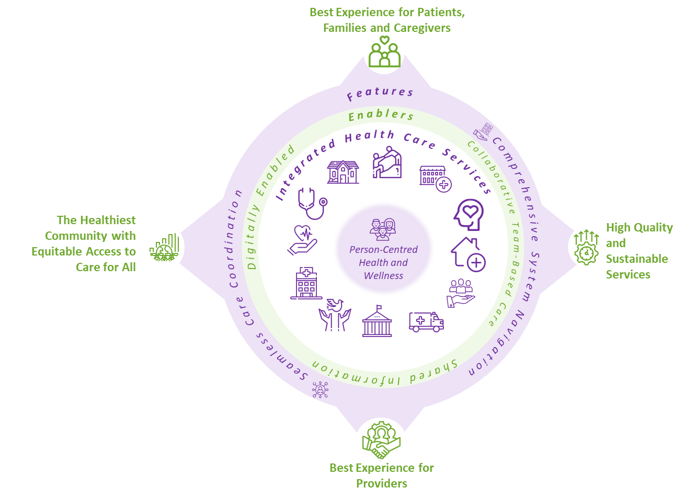
Year 1 Population
In Year 1, the Elgin OHT partners will focus on the respiratory health of Elgin country residents who are 65 year and older
Elgin’s Year 1 target population will include patients with COPD
Note: The cohort of people served by the Elgin OHT in Year 1 will be identified based on various respiratory risk factors and through Elgin primary care, community para-medicine contact, STEGH Emergency Department, or on admission to STEGH
~ 5322
Patients with COPD¹
Elgin OHT Total Population: 69,118
¹ COPD patients = 69,118 x 7.7% (prevalence of COPD in Elgin County)

Slide 15
Opportunities raised during sub-committee meetings
Building on current initiatives (i.e., Best Care and PREVENT, etc.)
Focus on improving transitions (i.e., from hospital, etc.)
Build on various innovative service models already used in Elgin (i.e., Rapid Response Nurse Model, Community Paramedic, etc.)
Continuing and scaling the successful use of digital systems and virtual care
Focus on mechanisms and agreements for sharing information and data
Addressing barriers to digital enablement

Slide 16
Collaborative Decision-Making Arrangements
The Ministry released a new streamline OHT application and guidance on July 24th
Based on lessons learned during first round of application, MOH has shifted to focus the term “collaborative decision-making arrangements (CDMA)” rather than the term “governance” to reflect that OHTs are still in early stages of implementation, including that:
At this time, patient services continue to be funded and governed by agreements between the funder and each member within an OHT, and not (yet) through an integrated agreement between the funder and the OHT as a whole; and
OHT members need time to work out the scope of decision-making they assign to the OHT (vs. the scope of decision-making authority retained by individual members).

Slide 17
Collaborative Decision-Making Arrangements
Collaborative governance is a governing arrangement in which leaders from organizations drawn from multiple sectors engage in a collective decision-making process that is:
Deliberative
Consensus-oriented
Directed to the achievement of a shared goal
Choices about end state governance structures are not needed for the Full Application or even during Year 1 – although approved OHT’s will need to establish Collaborative Decision-Making Arrangements to be eligible to receive one-time implementation funding in Year 1

Slide 18
OHT Implementation Funding
Teams must be approved OHTs who have attested to meeting minimum CDMA requirements in order to be eligible for Ministry OHT Implementation Funding
Funding Amounts
Approximately $375,000 per team in FY2020-21, starting Oct 1*
Approximately $750,000 per team in FY2021-22, starting April 1* * pro-rated based on when team is approved and submits its forms
Eligible Spending
Digital health and virtual care
Physician and other clinician leadership and engagement Patient, family, and caregiver engagement and participation
Project leadership and management
Performance measurement and quality improvement
Exclusions
Consultant services
Items or activities available through the central program of supports
Activities, supplies, or equipment supported by other funding sources (e.g. personal protective equipment).

Slide 19
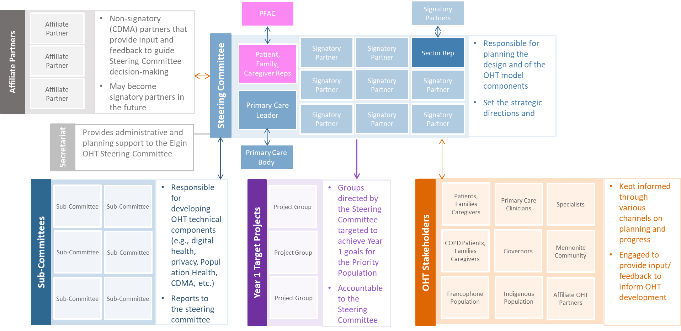
Collaborative Decision Making Arrangements (CMDA) and Engagement Model
Year 1
The Steering Committee and Governance Sub-Committee developed a draft "straw dog" CMDA for Year 1, and initiated discussion on potential future state models.
The CMDA model does not need to be included in the Full Application – but will serve as the basis for ongoing refinement and elaboration by OHT partners.

Slide 20
"Straw Dog" Year 1 Collaborative Decision-Making Arrangement (CDMA) and Engagement Model
PFAC
Signatory Partners
Affiliate Partners
Affiliate Partner
Non-signatory (CDMA) partners that provide input and feedback to guide Steering Committee decision-making
May become signatory partners in the future
Steering Committee
Signatory Partner
Signatory Partner
Sector Rep
Responsible for planning the design and of the OHT model components
Set the strategic directions and
Affiliate Partner
Patient, Family, Caregiver Reps
Signatory Partner
Signatory Partner
Signatory Partner
Affiliate Partner
Primary Care Leader
Signatory Partner
Signatory Partner
Signatory Partner
Secretariat
Provides administrative and planning support to the Elgin OHT Steering Committee
Primary Care Body
Sub-Committees
Sub-Committee
Sub-Committee
Responsible for developing OHT technical components (e.g., digital health, privacy, Population Health, CDMA, etc.)
Reports to the steering committee
Year 1 Target Projects
Project Group
Groups directed by the Steering Committee targeted to achieve Year 1 goals for the Priority Population
Accountable to the Steering Committee
OHT Stakeholders
Patients, Families Caregivers
Primary Care Clinicians
Specialists
Kept informed through various channels on planning and progress
Engaged to provide input/ feedback to inform OHT development
Sub-Committee
Sub-Committee
Project Group
COPD Patients, Families Caregivers
Governors
Mennonite Community
Sub-Committee
Sub-Committee
Project Group
Francophone Population
Indigenous Population
Affiliate OHT Partners

Slide 21
Elgin OHT Possible Year 1 Membership Levels
CDMA Signatory Partners
Affiliate Partners
Sign the Collaborative Decision-Making Agreement
Are have representation in the Elgin OHT Steering Committee
Provide input to guide the decisions and priorities of the OHT
Make decisions in collaboration with the other Signatory Partners of the Steering Committee – focus on consensus decision-making
Contributes resources (according to ability)
Do not sign the Collaborative Decision-Making Agreement
Are engaged by the Elgin OHT Steering Committee (e.g. special all member meetings, communications, etc.) in order to provide input to guide the decisions and priorities of the OHT – but not involved in formal decision-making
Affiliate member representatives may participate Sub-Committee and Projects

Slide 22
OHT Application Sign-Off Process
1
OHT Application Sign-off Process

Slide 23
OHT Application Sign-off Process
Member organizations are not making any formal commitments at this time as a signatory to the Full Application
By signing applications, signatories indicate they have taken appropriate steps to ensure that the content of this application is accurate and complete.
For organizations, board chair sign-off is required.
For primary care, both organizations (FHT and physician groups) should sign. It is not required that all physicians in a group sign - but number of physicians not signing where their group has signed should be noted.

Slide 24
Next Steps
1
Next Steps

Slide 25
Key Messages regarding Next Steps
Dates for next round of applications approvals has not yet been confirmed by MOH.
Steering Committee will shift focus to initiating implementation planning in anticipation of approval early in new year
Ongoing stakeholder engagement

